Slide 1
File and Directory Naming
BDK12-2 | Data Annotation and Curation
Nicole Vasilevsky | OHSU Library – Ontology Development Group

Slide 2
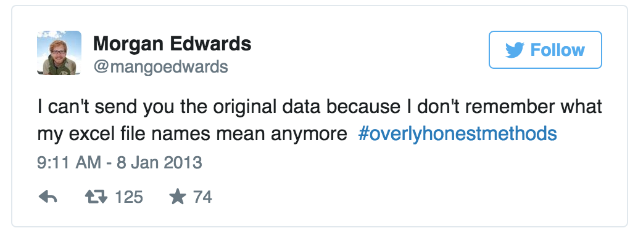
https://storify.com/BeckiePort/overlyhonestmethods

Slide 3
Do you have directory and file naming conventions?

Slide 4
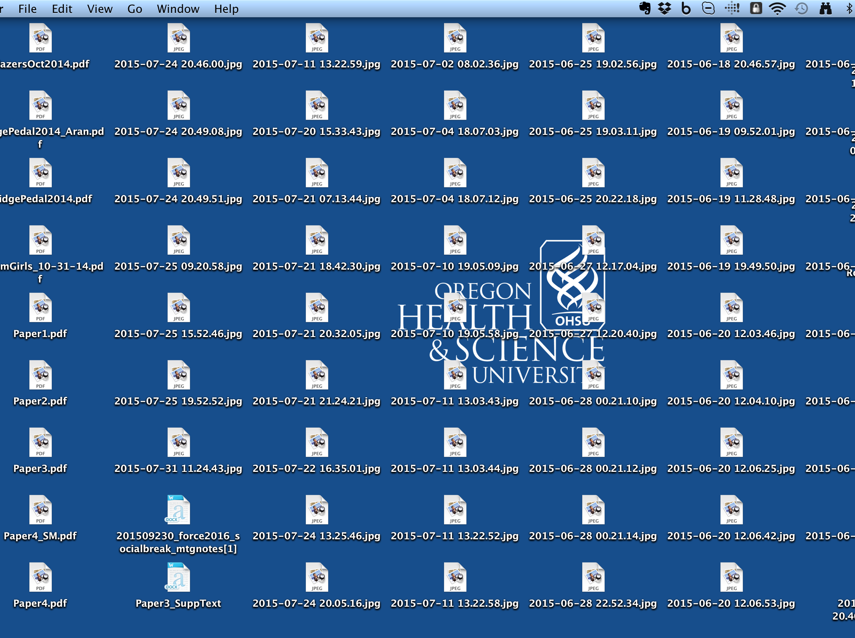
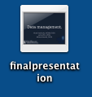

Slide 5
Naming conventions
Retain order
s/n, variable
Project_instrument_location_YYYY-MM- DD_extra.ext
Index/grant
conditions
Leading zero!

Slide 6

Naming conventions
Include a date using the format recommended by ISO 8601:
YYYY-MM-DD
Example:
2015-02-26

Slide 7
Avoid special characters and spaces
“ / \ : * ? “ < > [ ] & $
Use underscores (_) not spaces to separate terms
These characters have specific meanings in your computer's operating system that could result in misreading or deleting these files

Slide 8
CamelCase
Which of the following text strings are properly using camel case?
BDK14Presentation2015-07-21
BD2KOpenEducationalResourcesPresentation
BD2K Open Educational Resources Presentation
All of the above

Slide 9
CamelCase
Which is the best file name and format for a text document containing a list of your survey data?
SurveyData_2015-12-01-15.docx
SurveyData.120115.txt
Survey Data
SurveyData_2015-12-01.txt

Slide 10

Naming: Directory structure
Presentations
Work presentation
School presentation
Personal presentation
Work
School
Personal

Slide 11
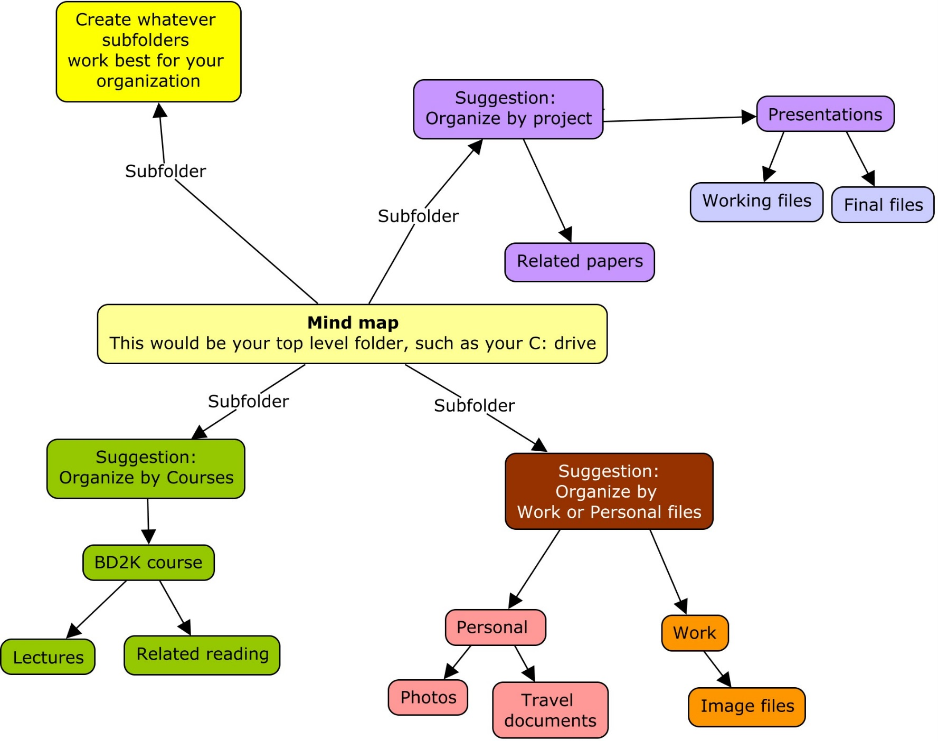

http://ftp.ihmc.us/

Slide 12
Thank you
This course was made possible under a grant from the NIH (# 1R25GM114820-01)

